Slide 1

Online Practice and
On the Move
Registration tutorial

Slide 2
Online
Practice
Registration

Slide 3
Step 1: Visit http://www.smartchoicepractice.com
Click here!

Slide 4
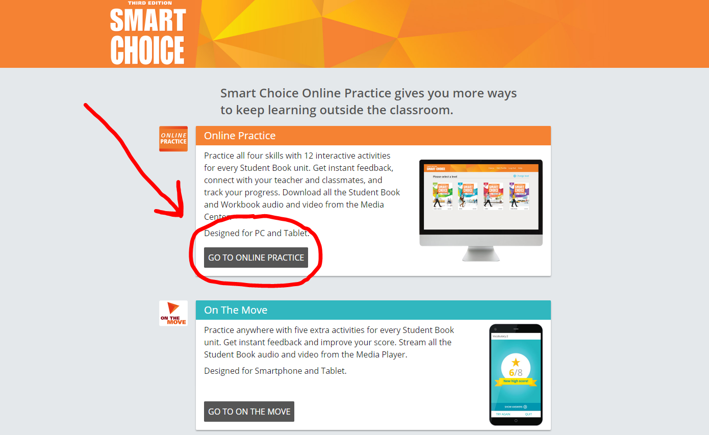
Step 2: Click “go to online practice”

Slide 5
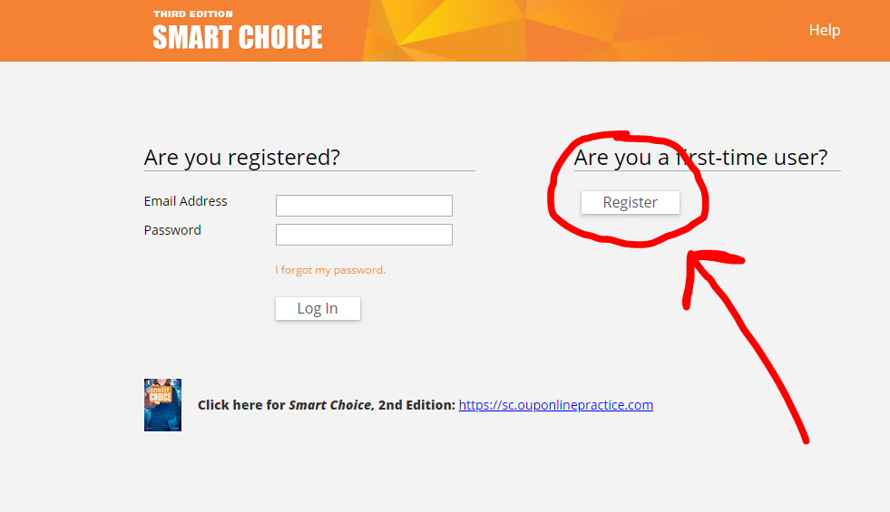
Step 3: Click “Register”

Slide 6
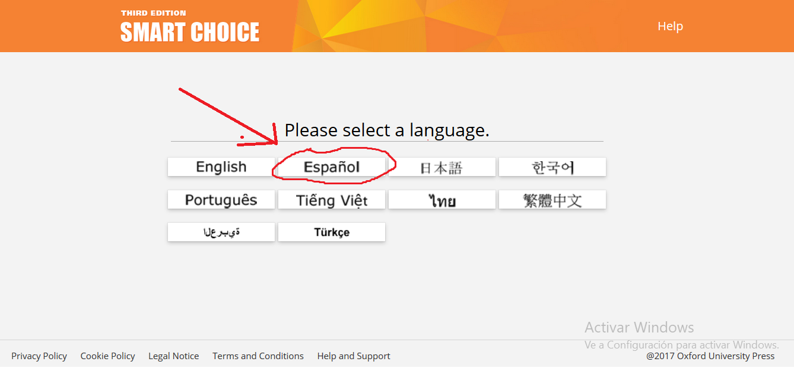
Step 4: Choose your language

Slide 7
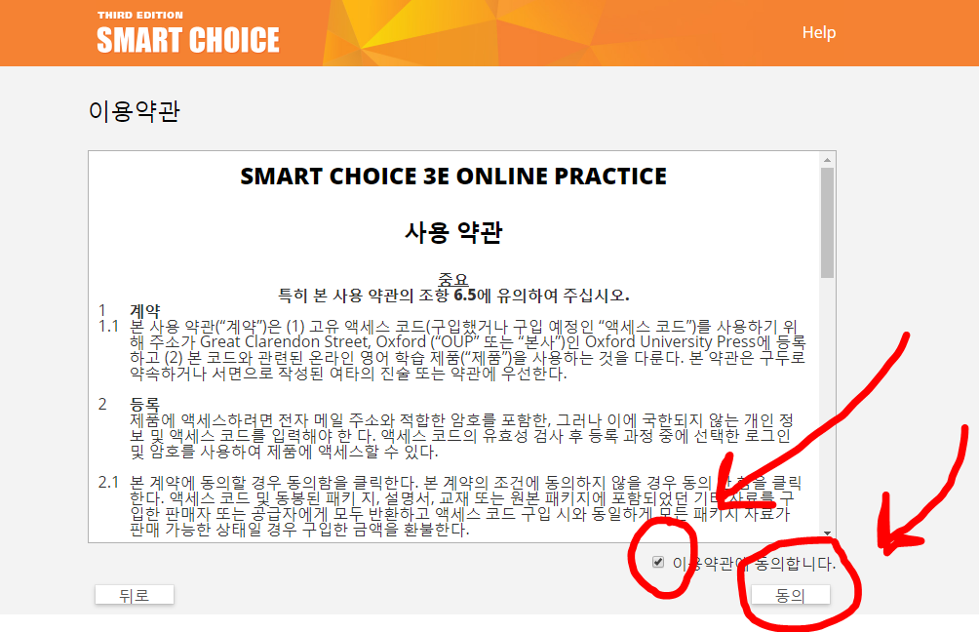
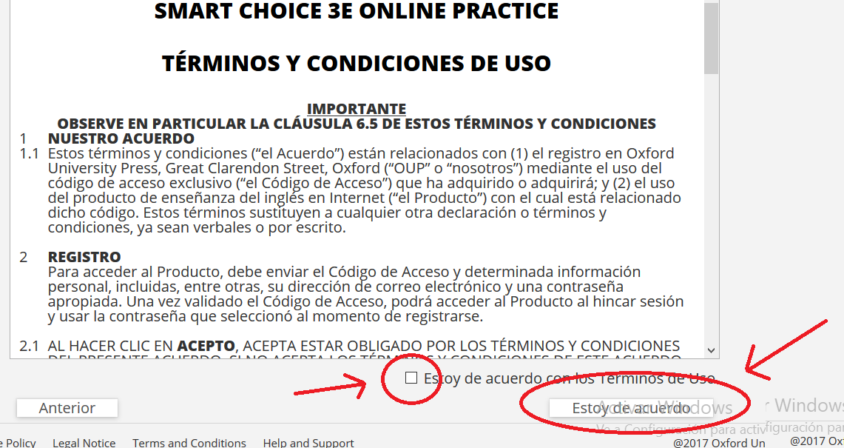
Step 5: Read and agree to terms and conditions

Slide 8
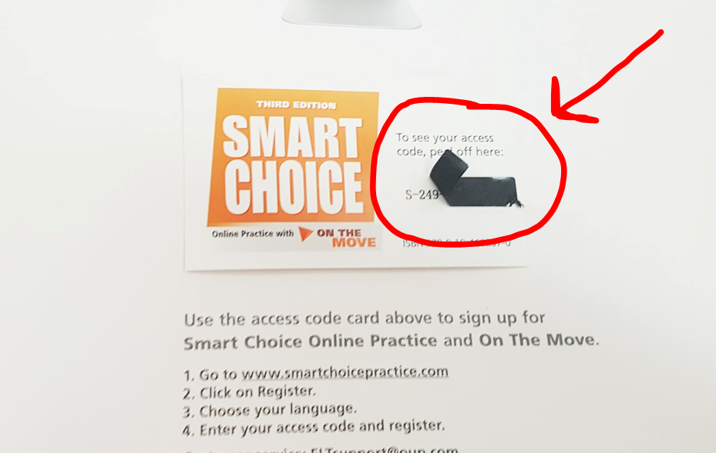
Step 6: Find your access code in your textbook…

Slide 9
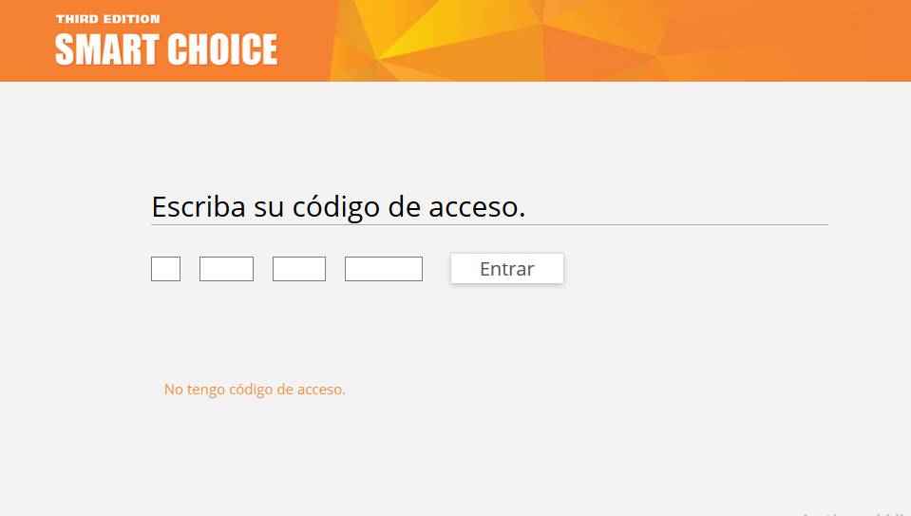
Step 6: … and type it into the blank spaces

Slide 10
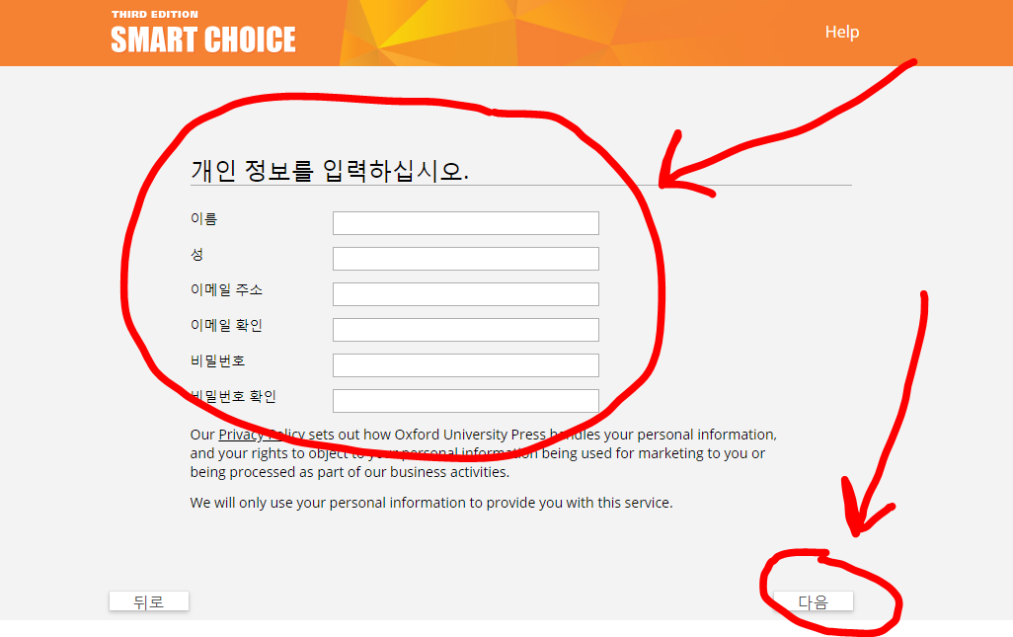
Step 7: Type your information and password

Slide 11
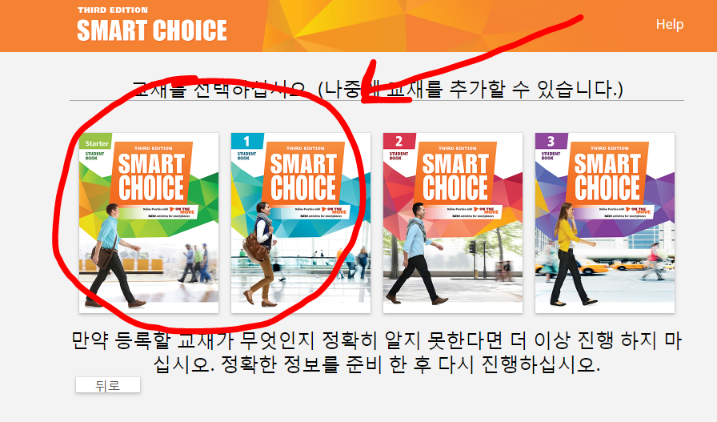
Step 8: Choose your textbook…

Slide 12
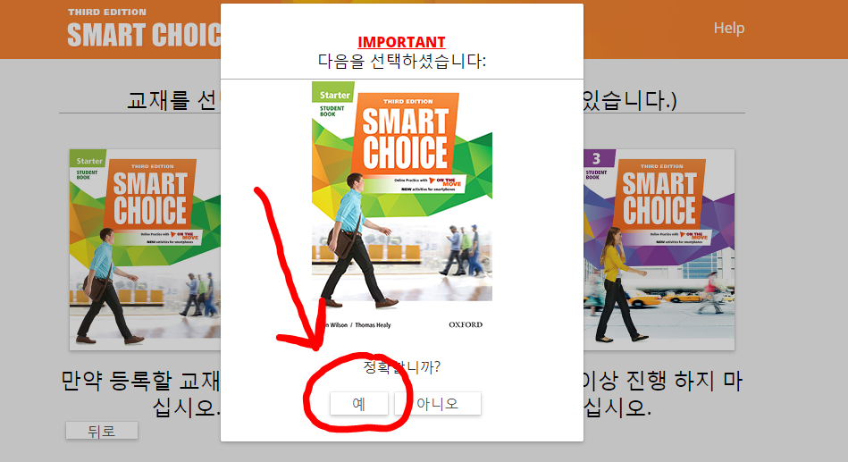
Step 8: … and verify you made the correct choice

Slide 13
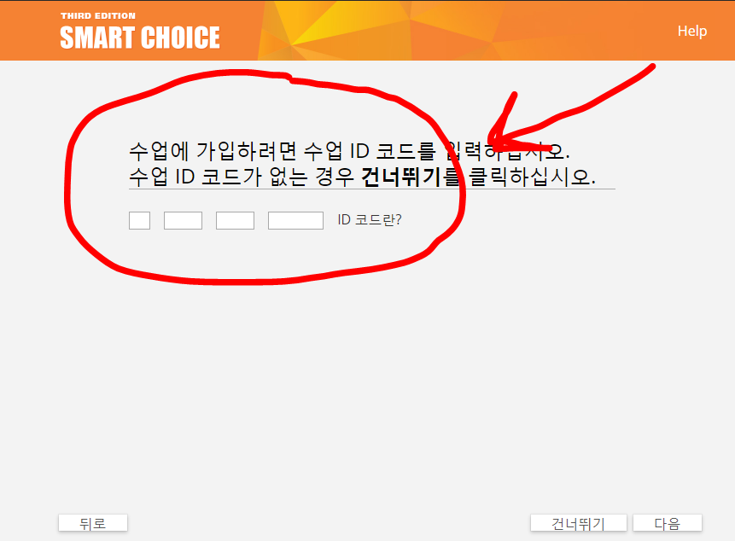

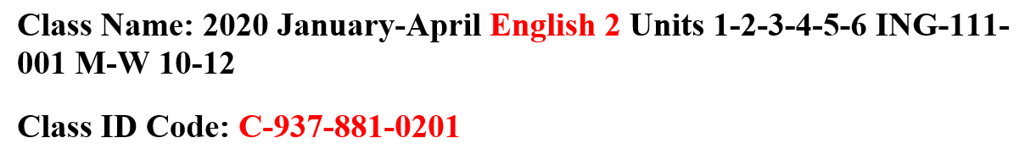
Step 9: Enter the class code your professor gave you and join your English class!
Ask your professor for help if you need it here.

Slide 14
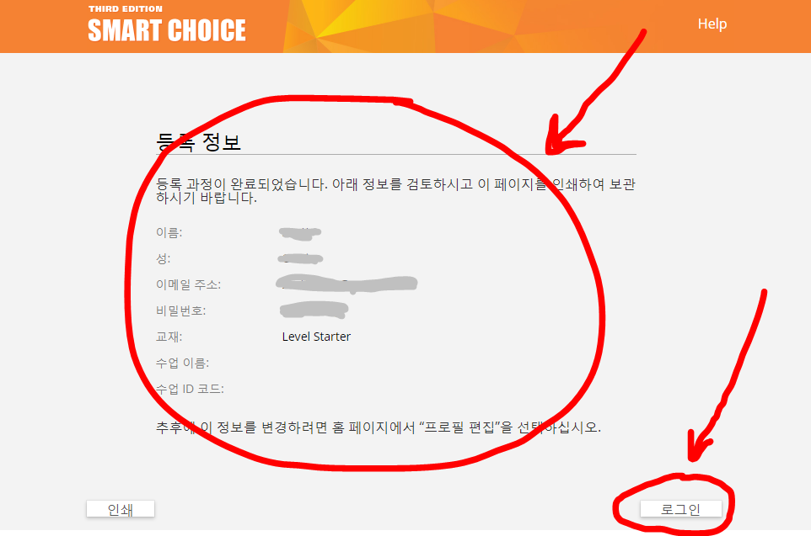
Step 10: Verify your information and click “log in”

Slide 15
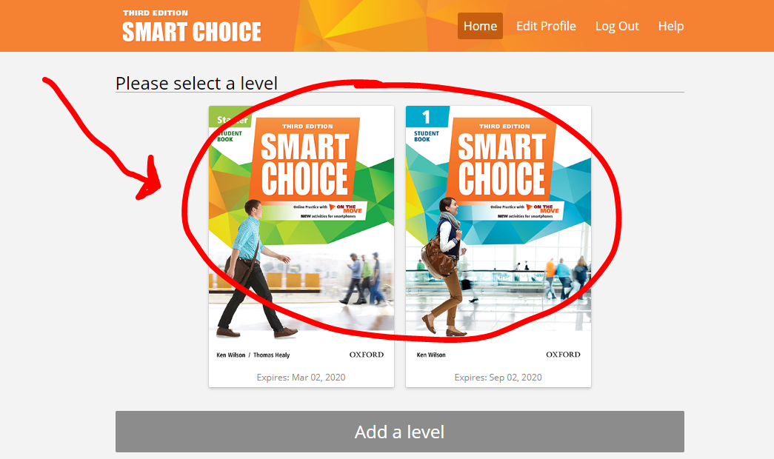
Step 11: Choose your textbook

Slide 16
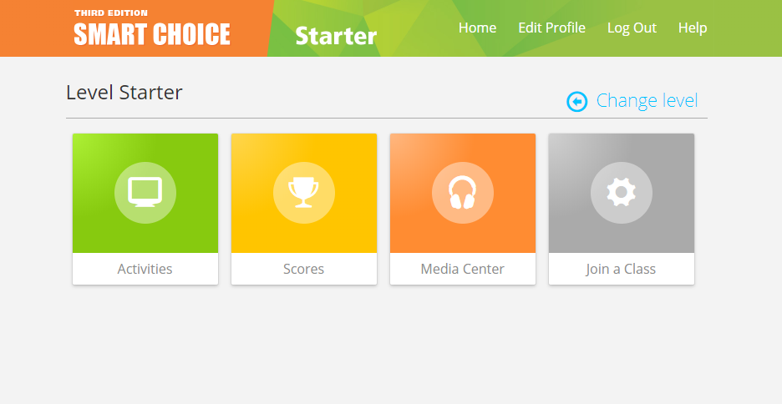
Step 12: Now you can use Online Practice tools!

Slide 17
On the Move

Slide 18
Step 1: Visit the ON THE MOVE website with your smart phone or tablet https://m-sc3e.ouponlinepractice.com
Click here!

Slide 19
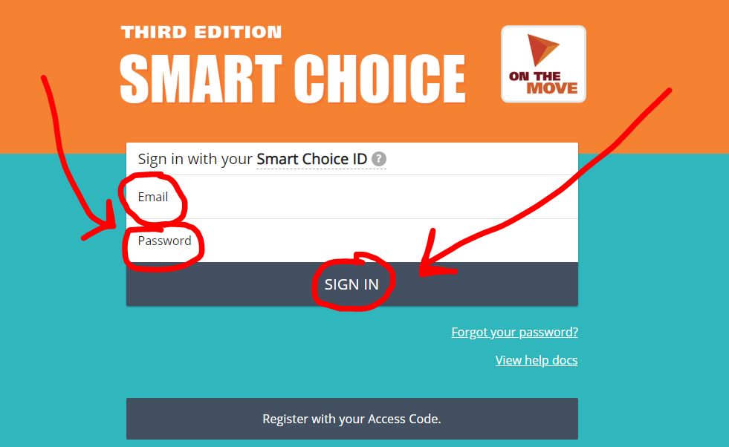
Step 2: Type your email and password

Slide 20
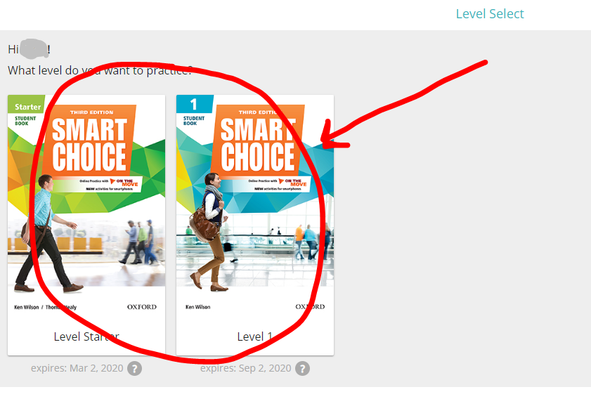
Step 3: Choose your level

Slide 21
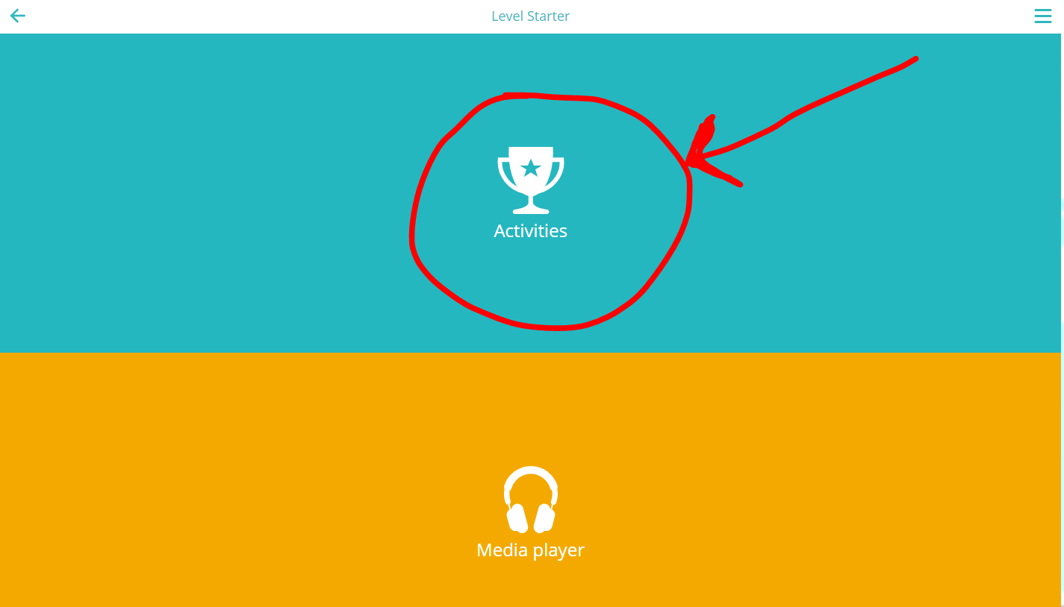
Step 4: Click on “Activities”

Slide 22
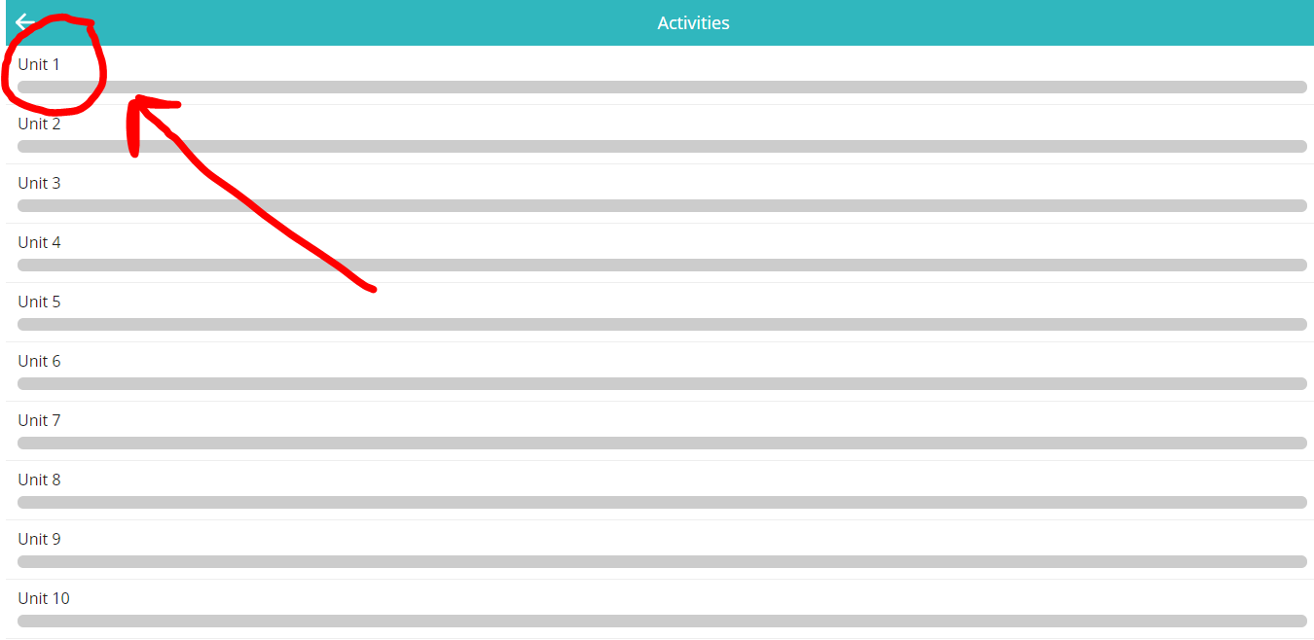
Step 5: Choose your unit

Slide 23
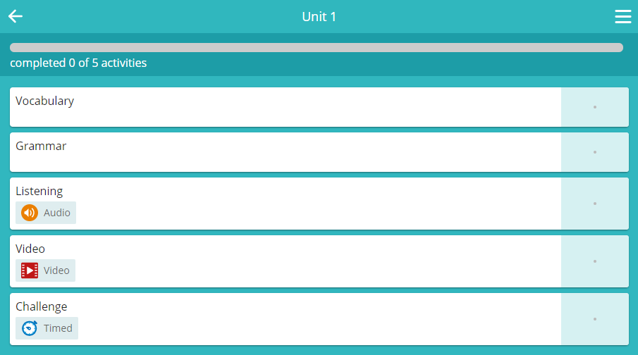
Step 6: Now you can use On the Move!

