Slide 1

Teacher:
Ángel Rafael Torres MA
Students:
Leander Lobequi De la Cruz--------2015-0217.
Visanel Jiménez ---------------------2015-0098.
Jacobo Peguero Ortiz-----------------2015-0276.
Eduardo Martínez---------------------2013-0294.

Slide 2
GROUP # 1
1-George Washington,
2- John Adams
Too/Not enough; Too Many/Too Much

Slide 3
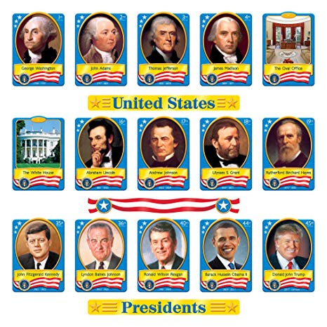
Presidents of the US

Slide 4
1 | George Washington | 1789 – 1797
2 | John Adams | 1797 – 1801
3 | Thomas Jefferson | 1801 – 1809
4 | James Madison | 1809 – 1817

Slide 5
5 | James Monroe | 1817 – 1825
6 | John Quincy Adams | 1825 – 1829
7 | Andrew Jackson | 1829 – 1837
8 | Martin van Buren | 1837 – 1841

Slide 6
9 | William Henry Harrison | 1841
10 | John Tyler | 1841 – 1845
11 | James Polk | 1845 – 1849
12 | Zachary Taylor | 1849 – 1850

Slide 7
13 | Millard Fillmore | 1850 – 1853
14 | Franklin Pierce | 1853 – 1857
15 | James Buchanan | 1857 – 1861
16 | Abraham Lincoln | 1861 – 1865

Slide 8
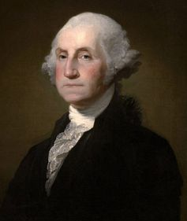
1- George Washington

Slide 9
George Washington was the First President of the United States.
Served as President: 1789-1797
Vice President: John Adams
Party: Federalist
Age at inauguration: 57
Born: February 22, 1732 in Westmoreland County, Virginia
Died: December 14, 1799 in Mount Vernon, Virginia
Married: Martha Dandridge Washington
Children: none (2 stepchildren)
Nickname: Father of His Country

Slide 10
What is George Washington most known for?
One of the most popular Presidents of the United States, George Washington is known for leading the Continental Army in victory over the British in the American Revolution. He also was the first President of the United States and helped to define what the role of the president would be going forward.

Slide 11
How did he die?
Just a few years after leaving the office of president, Washington caught a bad cold. He was soon very sick with a throat infection and died on December 14, 1799.

Slide 12
Fun Facts about George Washington
He was the only president unanimously elected. Meaning all of the state representatives voted for him.
He never served as president in Washington D.C., the capital that was named for him. In his first year the capital was in New York City, then moved to Philadelphia, Pennsylvania

Slide 13
He was six feet tall, which was very tall for the 1700s.
The story of George Washington chopping down his father's cherry tree is considered fiction and likely never happened.
George Washington did not have wooden teeth, but did wear dentures made from ivory.
Washington gave freedom to his slaves in his will.

Slide 14
1- What is George Washington most known for?
George Washington is known for leading the Continental Army in victory over the British in the American Revolution

Slide 15
2- George Washington was the president of the United States number…
George Washington was the first president of the United States

Slide 16
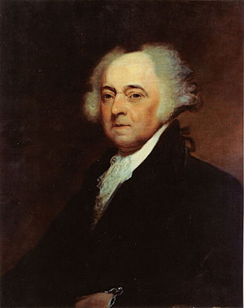
2- Jhon Adams

Slide 17
John Adams was the 2nd President of the United States.
Served as President: 1797-1801
Vice President: Thomas Jefferson
Party: Federalist
Age at inauguration: 61
Born: October 30 1735 in Braintree (now Quincy), Massachusetts
Died: July 4, 1826 in Braintree (now Quincy), Massachusetts
Married: Abigail Smith Adams
Children: 5 (Abigail, John Quincy, Charles, Thomas, and a daughter who died young)
Nickname: Father of American Independence

Slide 18
What is John Adams most known for?
John Adams was one of the founding fathers of the United States. He fought for American Independence as a Massachusetts delegate to the Continental Congress. He was a member of the team that worked on the Declaration of Independence and one of only two people who signed the Declaration to later become president (the other was Thomas Jefferson).

Slide 19
How did he die?
Adams lived to the ripe old age of 90 when he fell ill and died on July 4, 1826. In one of the more amazing coincidences of history, Adams died on the same day as Thomas Jefferson. This day was also the 50th anniversary of the approval of the Declaration of Independence!

Slide 20
Fun Facts about John Adams
Adams was married to his wife Abigail for 53 years. Abigail and John wrote many letters to each other over the years, sometimes daily.
He was overweight and some people called him by the nickname "His Rotundity".

Slide 21
Thomas Jefferson and Adams were rivals for the presidency. When Adams won, Jefferson became vice president because, at the time, the person with the second most votes for president became vice president.
His final words were "Thomas Jefferson still survives". However, he didn't know that Jefferson had died a few hours earlier.
Adams was the first president to live in the White House.
His son, John Quincy Adams, became the 6th President of the United States.

Slide 22
1- What is John Adams most known for?
He was a member of the team that worked on the Declaration of Independence

Slide 23
2- John Adams was the president of the United States number…
John Adams was the second president of the United States

Slide 24
GRAMMAR
Leander

Slide 25
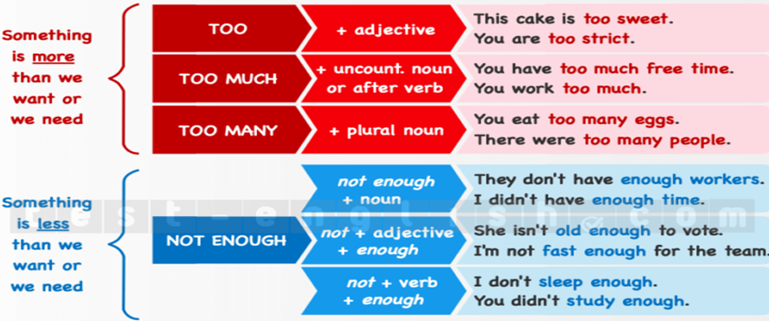

Slide 26
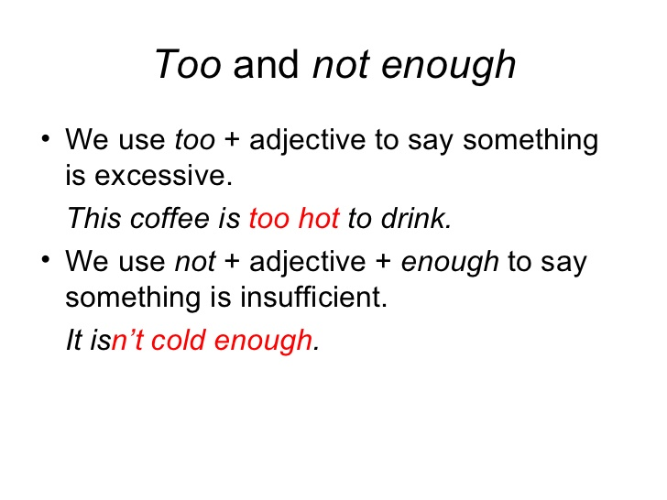

Slide 27
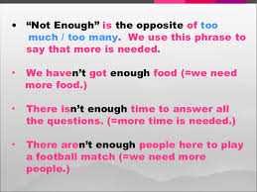

Slide 28
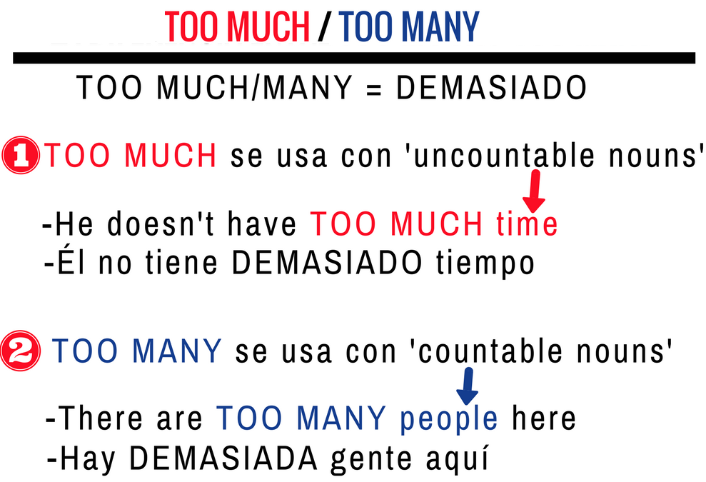

Slide 29
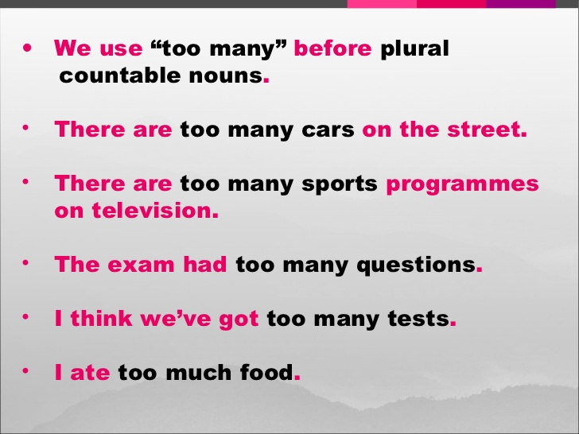

Slide 30
EXERCISES
Leander

Slide 31
1. Jack always gives stuff, you should thank him!
Too much

Slide 32
2. Tokyo is very crowded,
There are just people!
Too many

Slide 33
3. Some people have money and time.
What do they do with it all?
Too much
Too much

Slide 34
4. Venice in summer has tourists that visit each year.
Too many

Slide 35
5. My city has traffic during rush hour.
Too much

Slide 36
6. There are just cars on the road!
Too much

Slide 37
7. In my opinion Windows 8 had problems. I prefer Windows 7.
Too many

Slide 38
8. Parts of Africa have heat and sunshine, especially in summer.
Too much

Slide 39
9. I'm so busy! I have things to do today!
Too many

Slide 40
10. My friend Lily is addicted to
videogames. She can play for hours sometimes!
Too many

Slide 41
11. There is coffee in my cup
Too much

Slide 42
12. I see dogs in the park
Too many

Slide 43
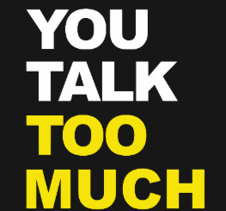
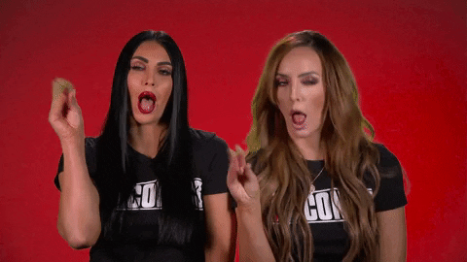

Slide 44
1) The room was (too – not enough) crowded, we couldn't get a seat.
1) The room was too crowded, we couldn't get a seat.

Slide 45
2) She doesn't live close (too – enough) to walk to work.
2) She doesn't live close enough to walk to work.

Slide 46
3) The service really wasn't good (too – enough)
3) The service really wasn't good enough

Slide 47
4) That restaurant is (too – not enough) expensive for me.
4) That restaurant is too expensive for me.

Slide 48
5) I'm not fit (too – enough) to run a marathon.
5) I'm not fit enough to run a marathon.

Slide 49
6) James is (too – not enough) young to drive. He is only 12.
6) James is too young to drive. He is only 12.

Slide 50
7) I was (too – enough) embarrassed to say anything.
7) I was too embarrassed to say anything.

Slide 51
8) Accidents happen when you are not careful (too – enough).
8) Accidents happen when you are not careful enough.

Slide 52

For your attention!!!
Leander

