Slide 1
English 3

Slide 2
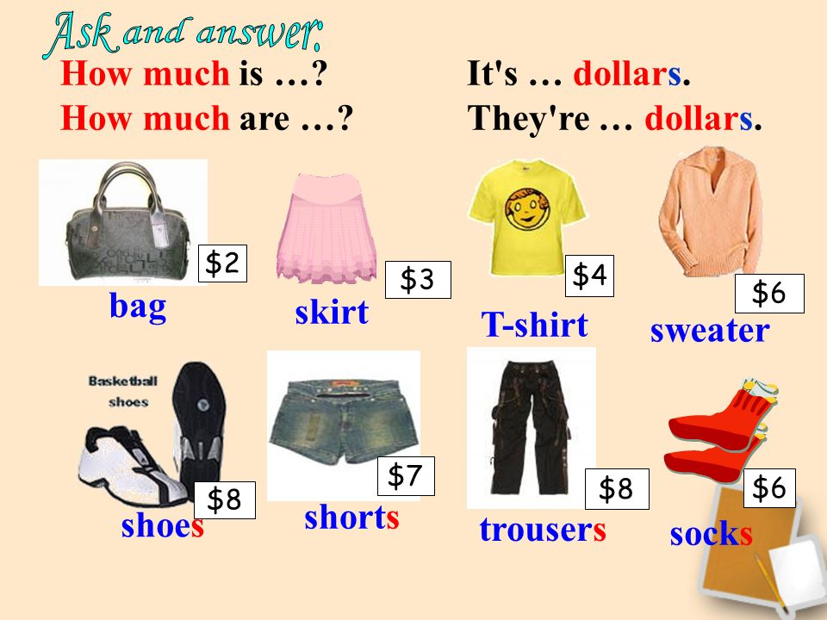

Slide 3
1. How much ______ the apples?
_____ pound a kilo

Slide 4
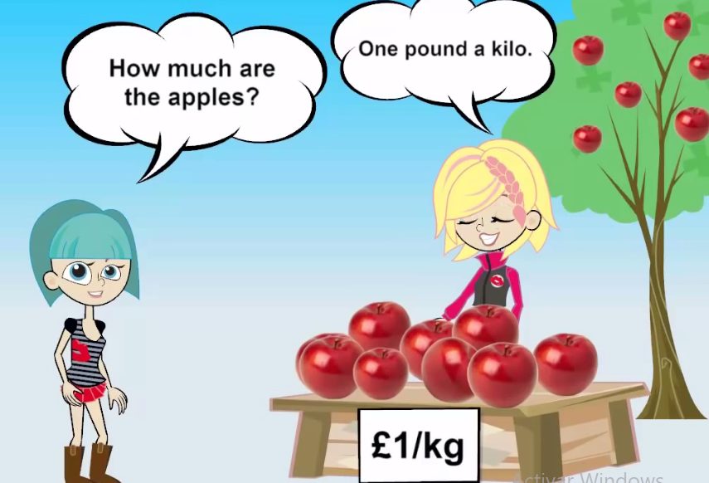
1. How much are the apples?
One pound a kilo

Slide 5
2. How much _____ the balls?
_____ pounds each

Slide 6
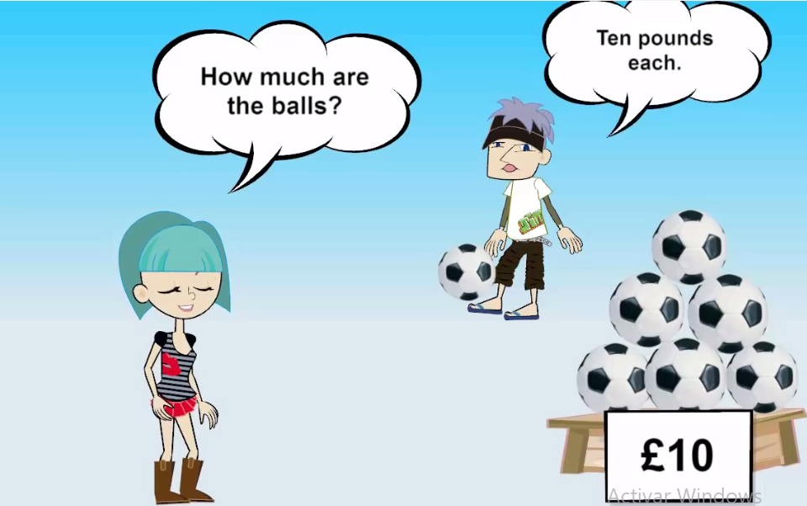

Slide 7
3. How much ____ the roses?
_____ pound each

Slide 8
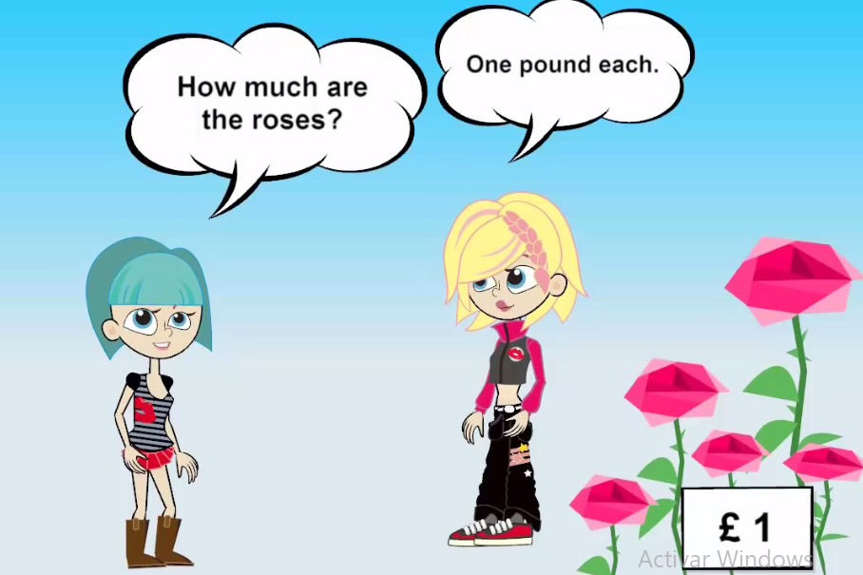

Slide 9
4. How much ____ the blue lamp?
_____ pounds

Slide 10
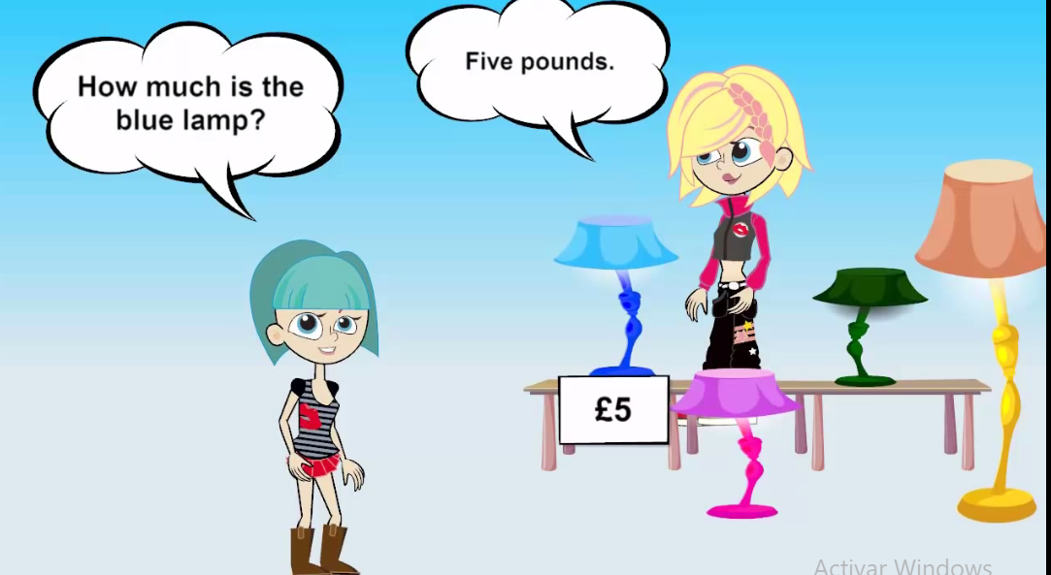

Slide 11
5. How much ____ the TV set?
_____ pounds

Slide 12


Slide 13
6. How much ____ the pink car?
_____ pounds

Slide 14
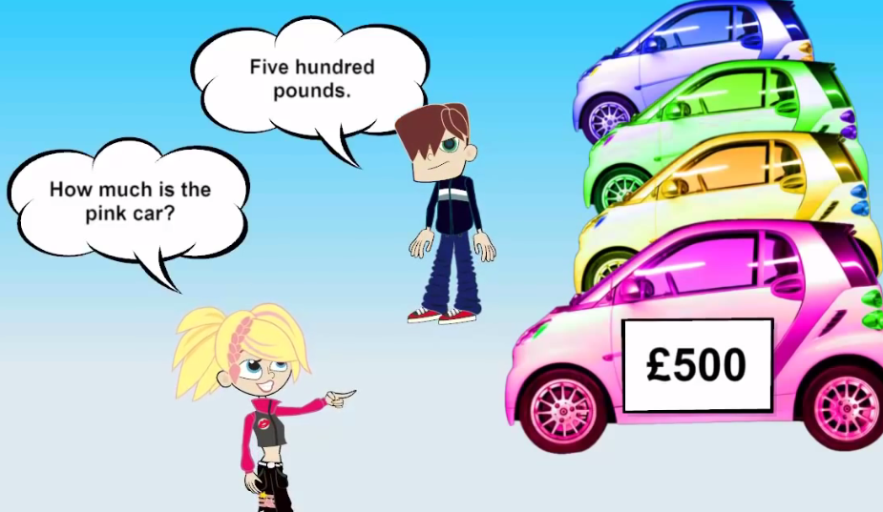

Slide 15
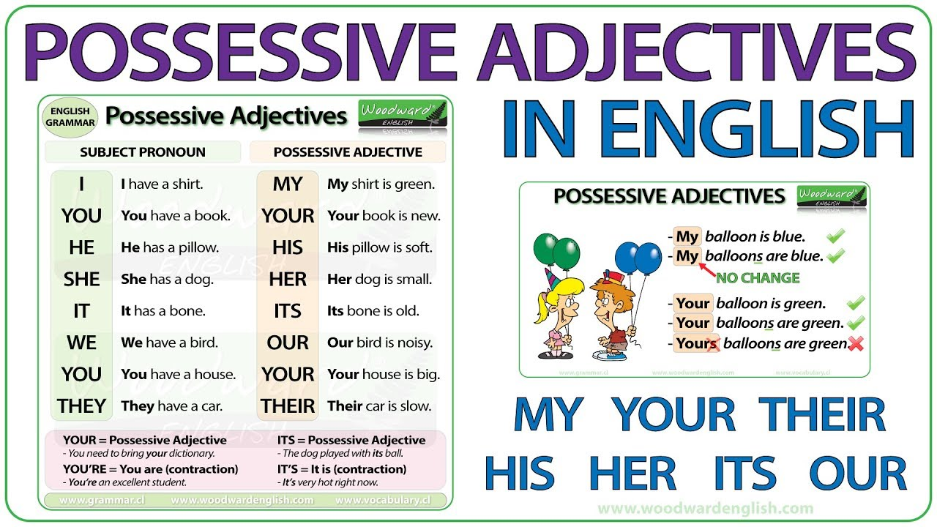
possessive adjectives. My, your, his, her, our, their

Slide 16
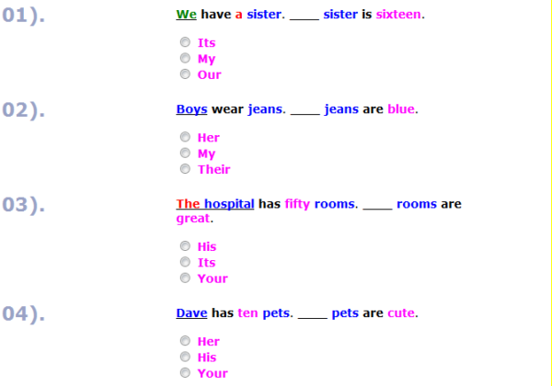

Slide 17
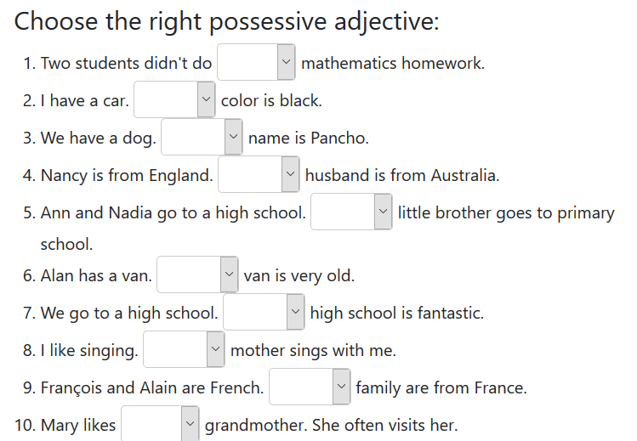


Slide 18
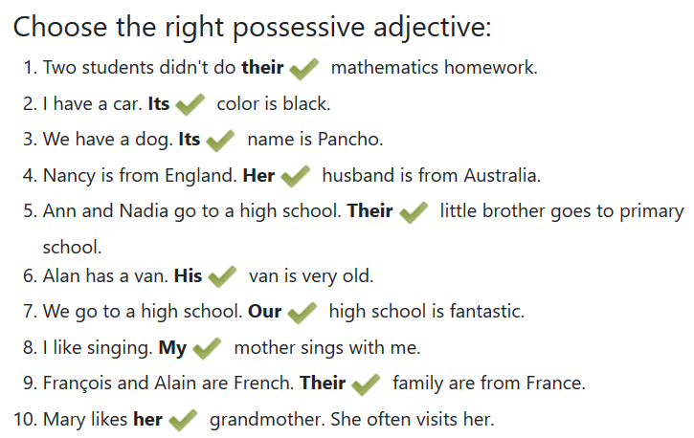

Slide 19
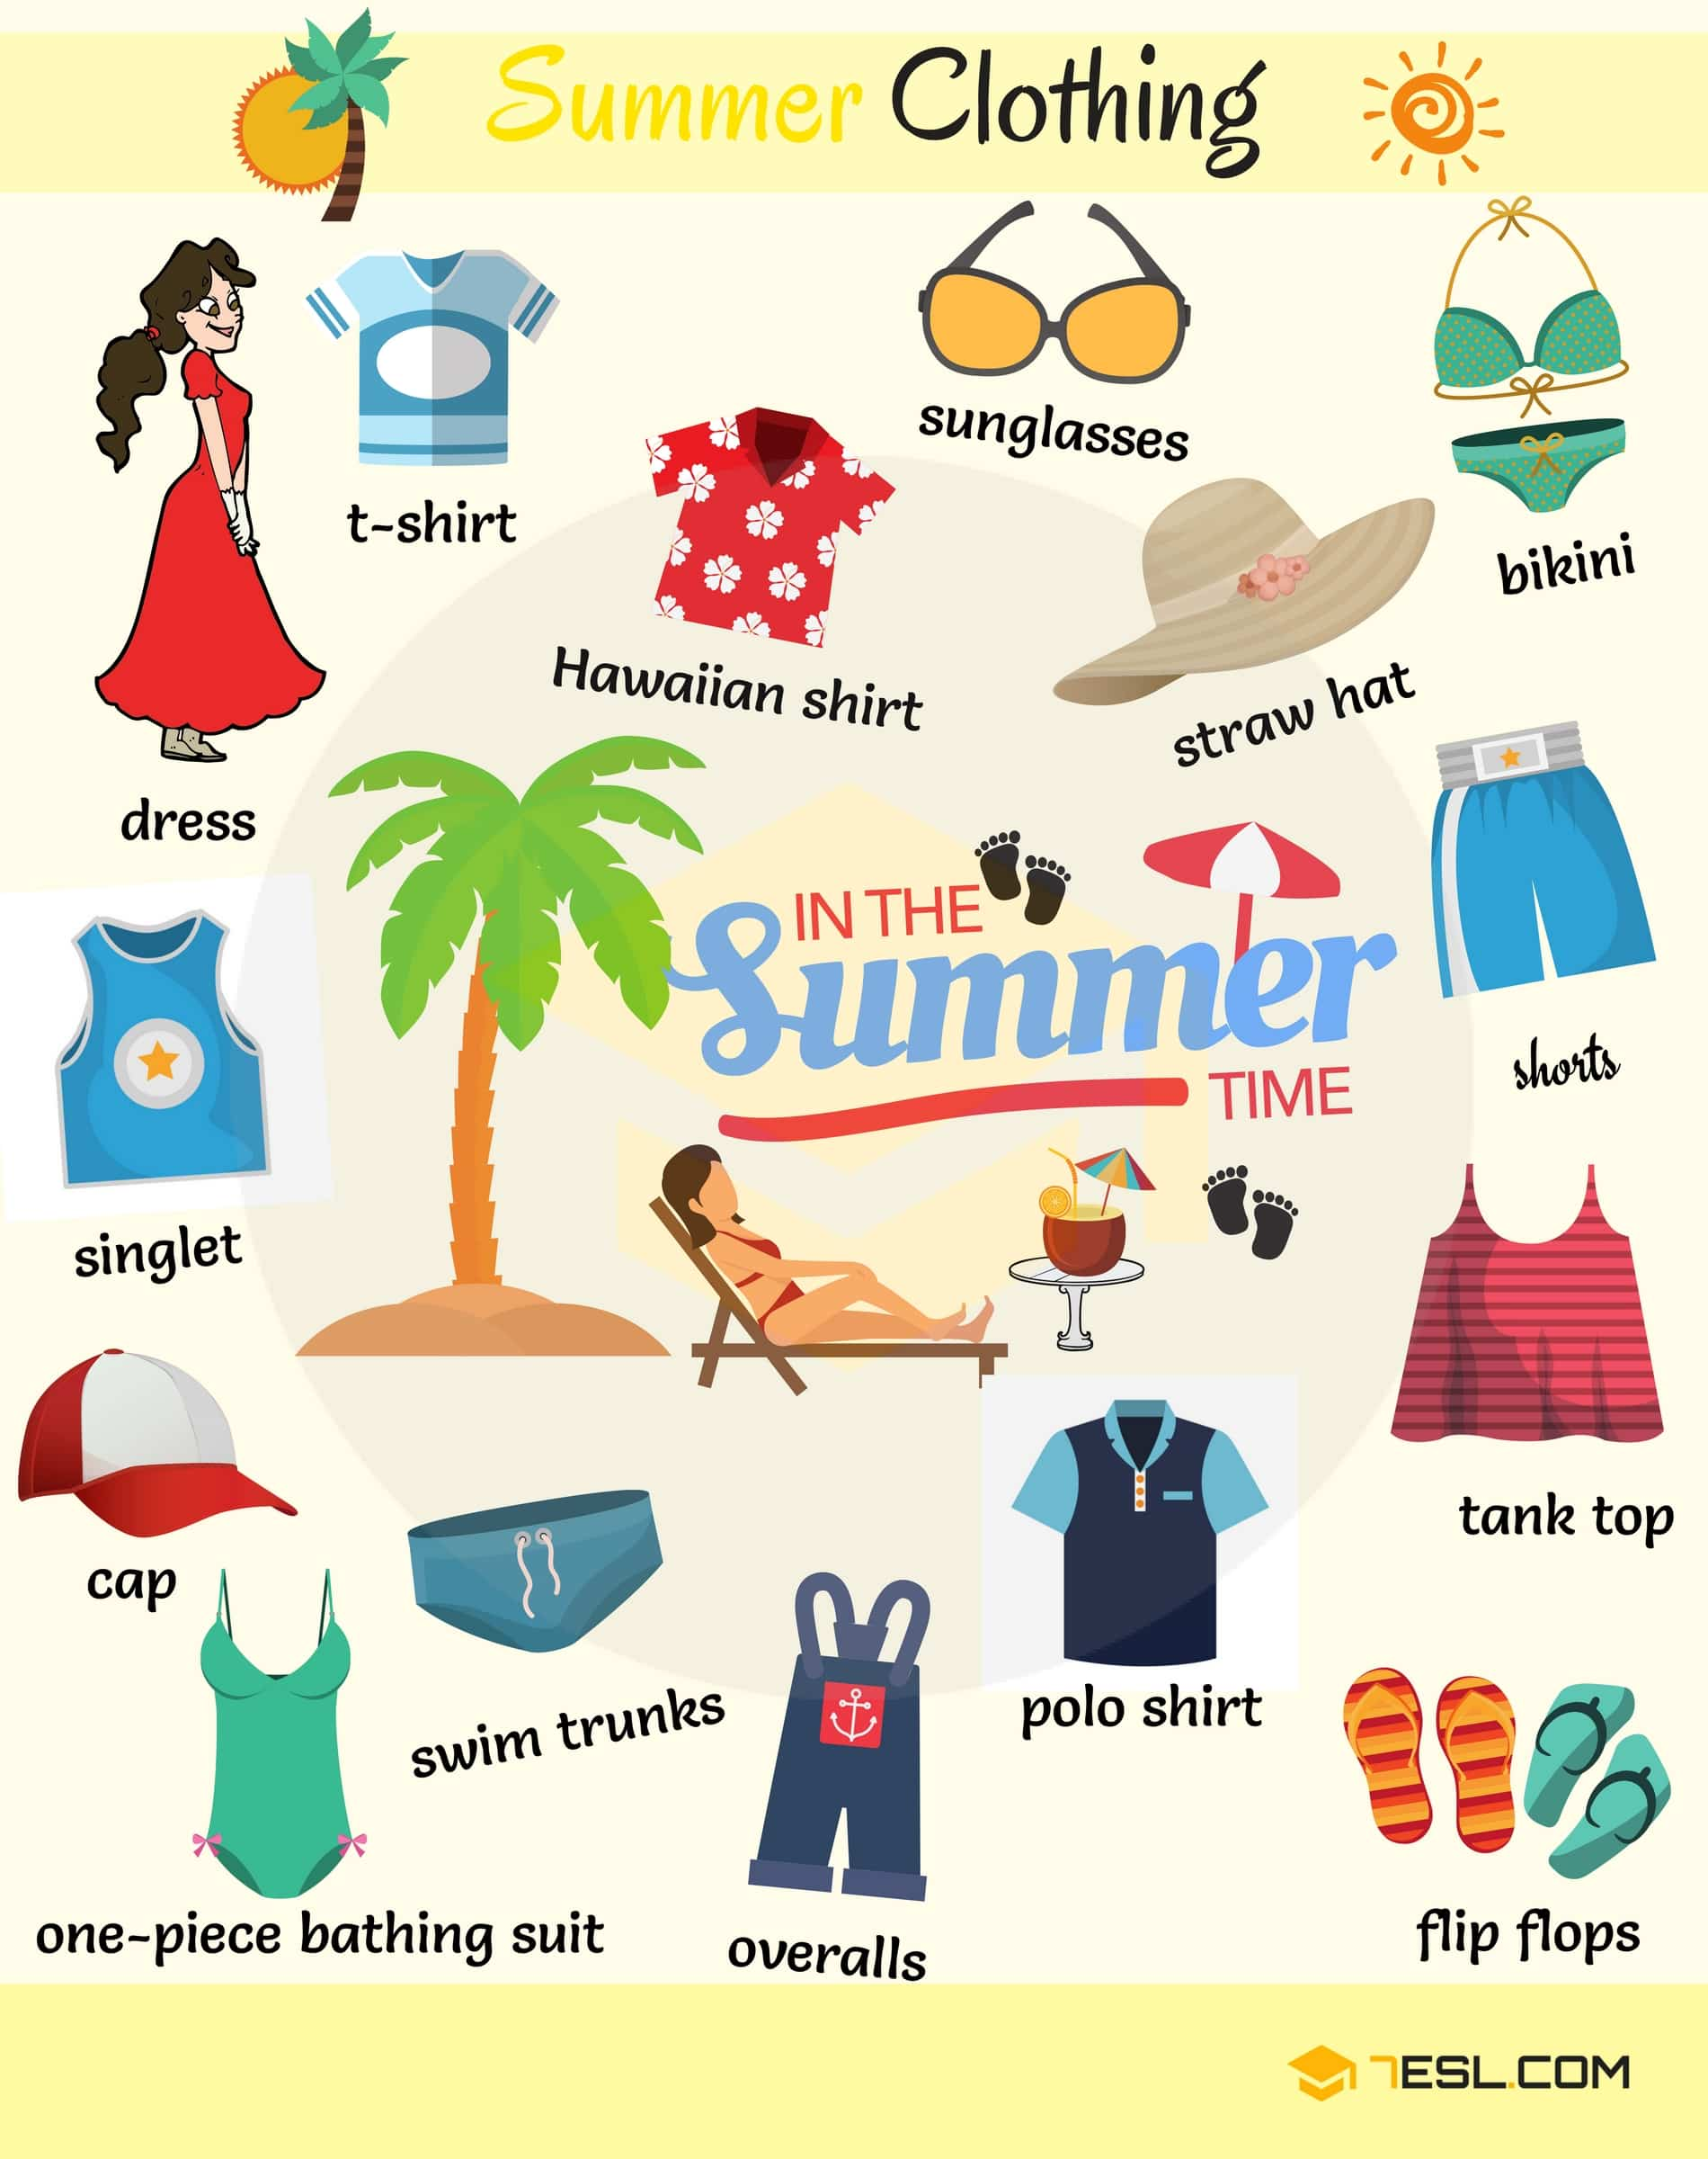


Slide 20
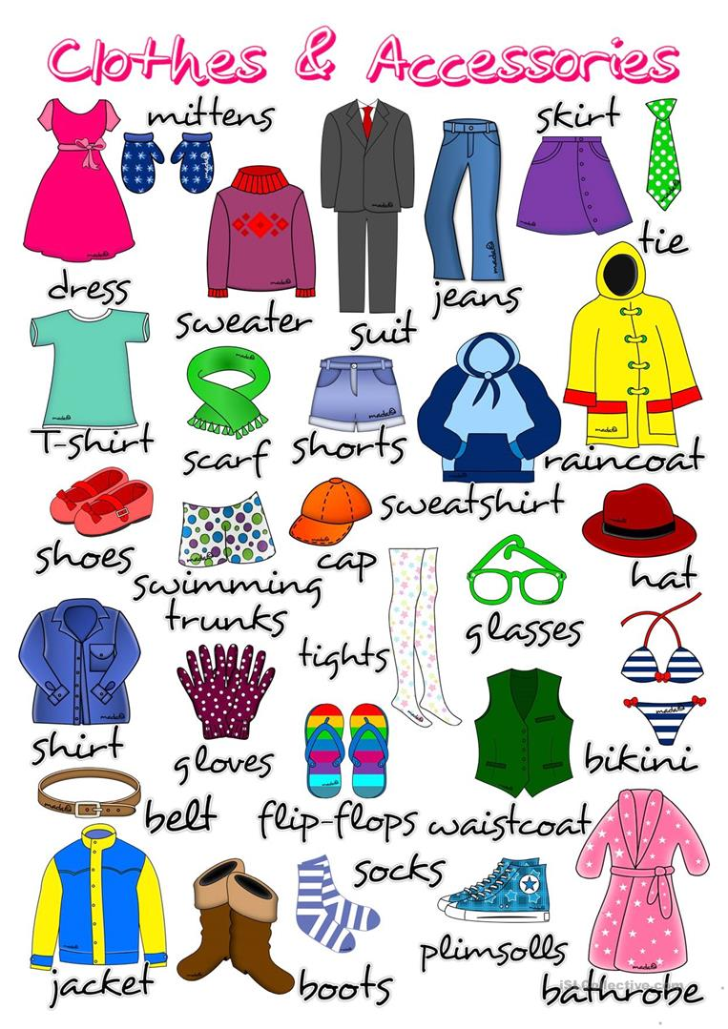

Slide 21
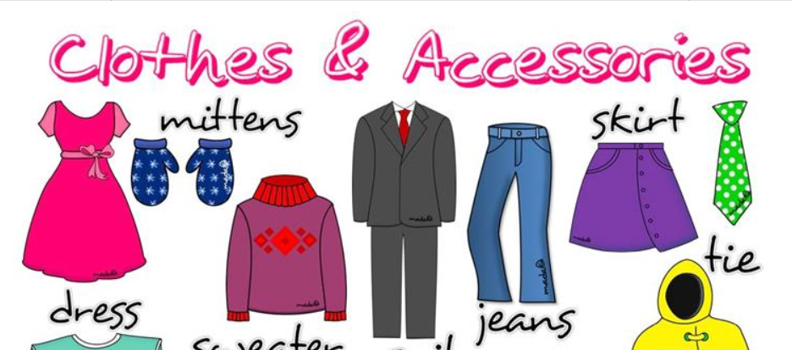

Slide 22
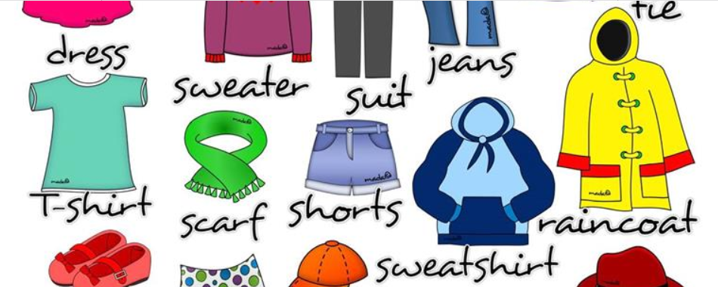

Slide 23


Slide 24


Slide 25


Slide 26


Slide 27

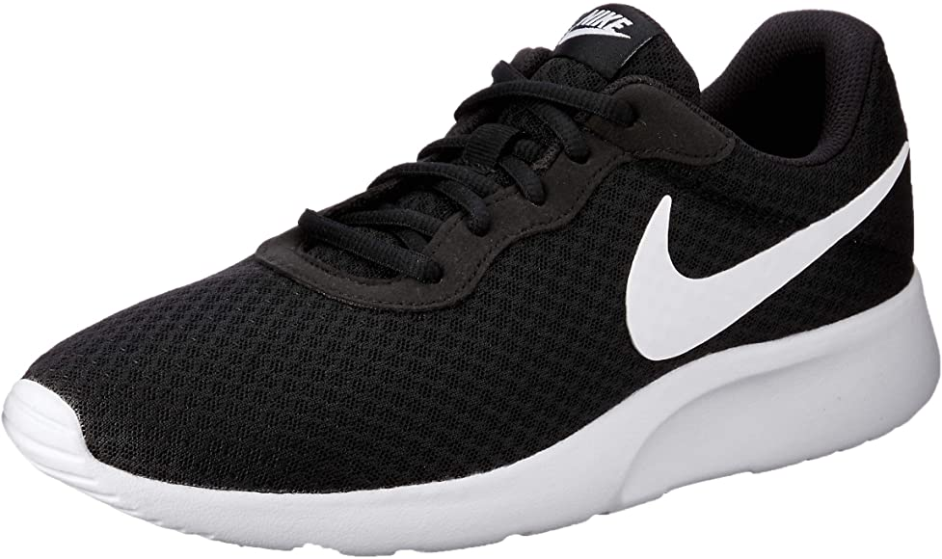

sneakers

Slide 28


Slide 29


Slide 30


Slide 31


Slide 32


Slide 33
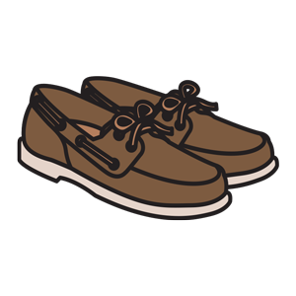
SHOES

Slide 34

