Slide 1

EXPOSITIONS
ENGLISH 3
Student1
Student 2

Slide 2

GROUP # 2: Talking about myself

Slide 3
SENTENCES

Slide 4
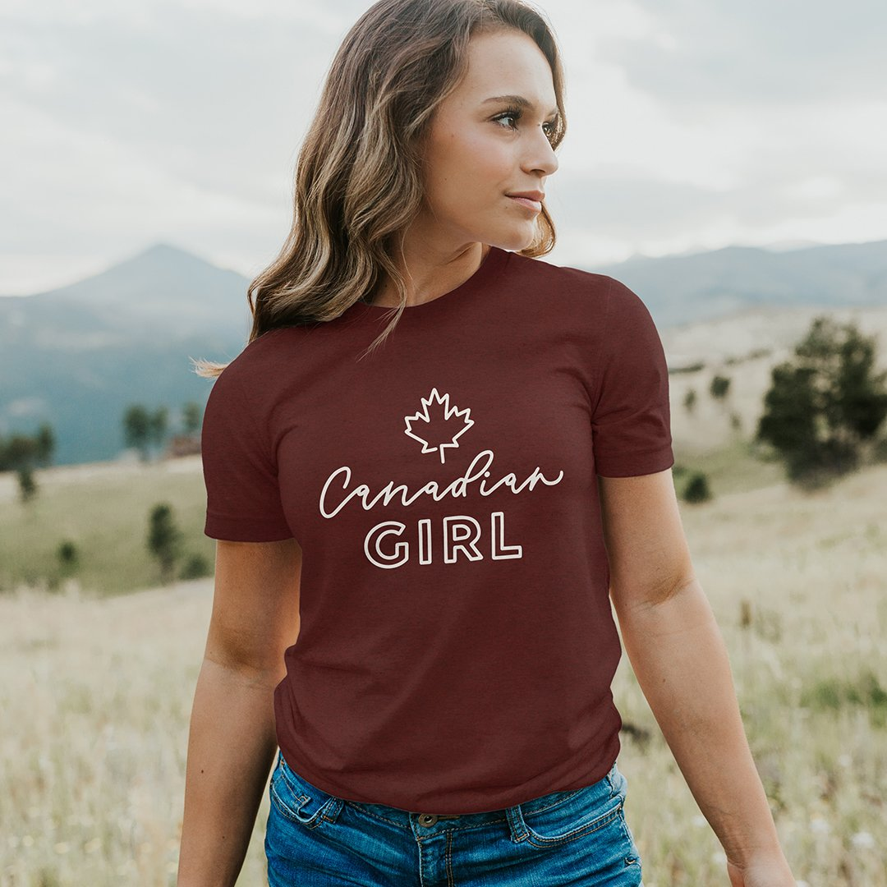
1. Hi everybody. My name is Grace. Today I’m going to talk about myself.

Slide 5

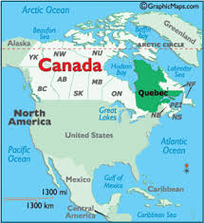
2. I am from Canada. I live in Montreal.

Slide 6

3. I am an engineer. I work in a factory.

Slide 7
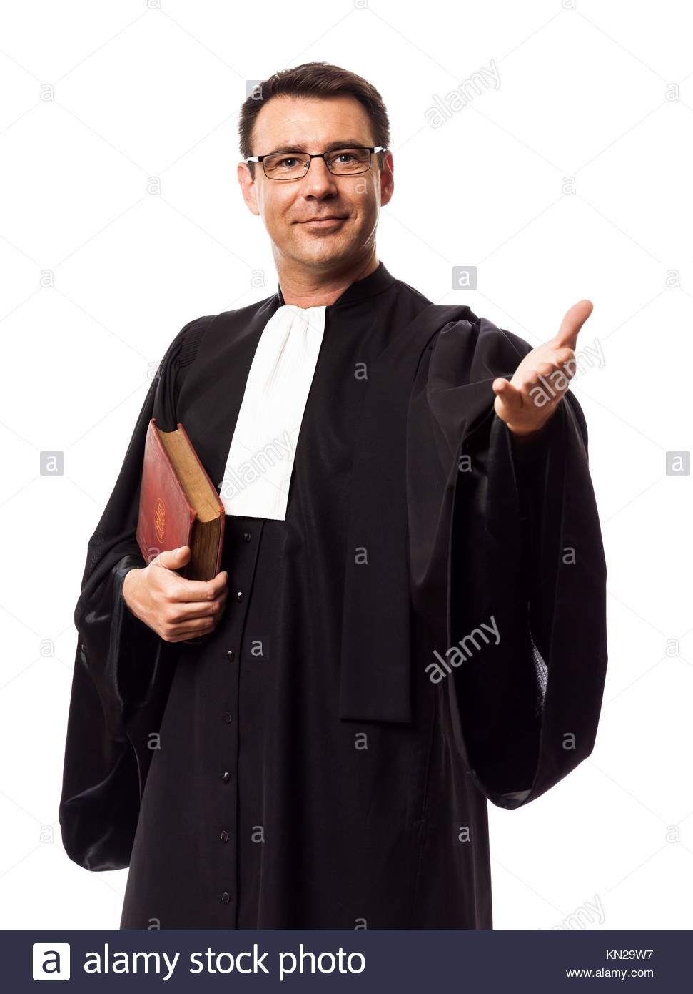
4. I am married. My husband is Henry. He is a lawyer.

Slide 8
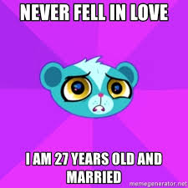
5. I am 27 years old.

Slide 9
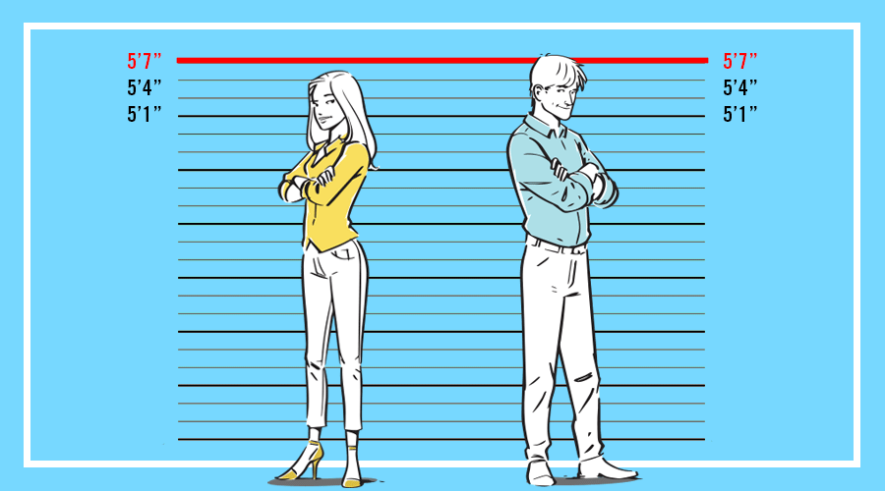
6. I am short. I am 5’4’’

Slide 10
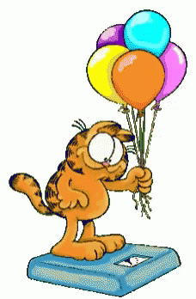
7. I am 150 pounds..

Slide 11
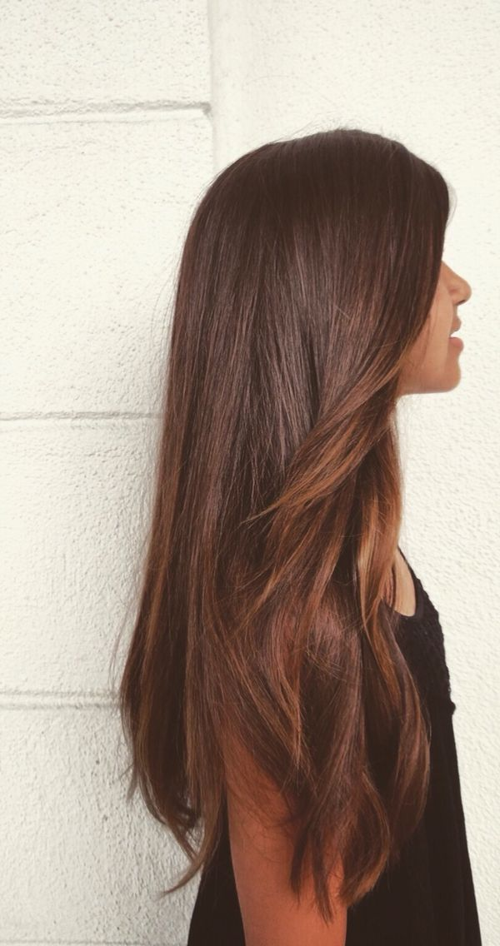
8. I have long brown hair

Slide 12
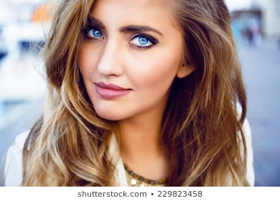
9. My eyes are blue and big.

Slide 13
Exercises

Slide 14

Matching. Put the numbers in front of the letters

Slide 15
1- What’s does Liz look like?
a- I’m 36 years old.
b- She has blue eyes.
c- They are from Spain
d- My weight is 180 pounds.
e- He’s 6’5’’.
f- I’m a chef
g- She is beautiful.
h- His hair is brown.

Slide 16
2- How tall is Edward?
a- I’m 36 years old.
b- She has blue eyes.
c- They are from Spain
d- My weight is 180 pounds.
e- He’s 6’5’’.
f- I’m a chef
g- She is beautiful.
h- His hair is brown.

Slide 17
3- How old are you?
a- I’m 36 years old.
b- She has blue eyes.
c- They are from Spain
d- My weight is 180 pounds.
e- He’s 6’5’’.
f- I’m a chef
g- She is beautiful.
h- His hair is brown.

Slide 18
4- What color hair does Phil have?
a- I’m 36 years old.
b- She has blue eyes.
c- They are from Spain
d- My weight is 180 pounds.
e- He’s 6’5’’.
f- I’m a chef
g- She is beautiful.
h- His hair is brown.

Slide 19
5- What do you do?
a- I’m 36 years old.
b- She has blue eyes.
c- They are from Spain
d- My weight is 180 pounds.
e- He’s 6’5’’.
f- I’m a chef
g- She is beautiful.
h- His hair is brown.

Slide 20
6- What’s your weight?
a- I’m 36 years old.
b- She has blue eyes.
c- They are from Spain
d- My weight is 180 pounds.
e- He’s 6’5’’.
f- I’m a chef
g- She is beautiful.
h- His hair is brown.

Slide 21
7- Where are they from?
a- I’m 36 years old.
b- She has blue eyes.
c- They are from Spain
d- My weight is 180 pounds.
e- He’s 6’5’’.
f- I’m a chef
g- She is beautiful.
h- His hair is brown.

Slide 22
8- What color eyes does Brit have?
a- I’m 36 years old.
b- She has blue eyes.
c- They are from Spain
d- My weight is 180 pounds.
e- He’s 6’5’’.
f- I’m a chef
g- She is beautiful.
h- His hair is brown.

Slide 23



