Slide 1

EXPOSITIONS
ENGLISH 3
Student1
Student 2

Slide 2
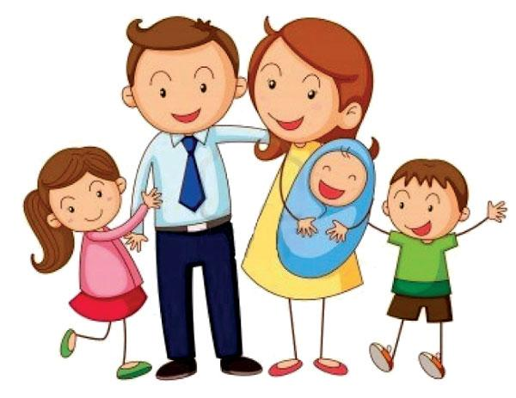
GROUP # 1: MY FAMILY

Slide 3
SENTENCES

Slide 4
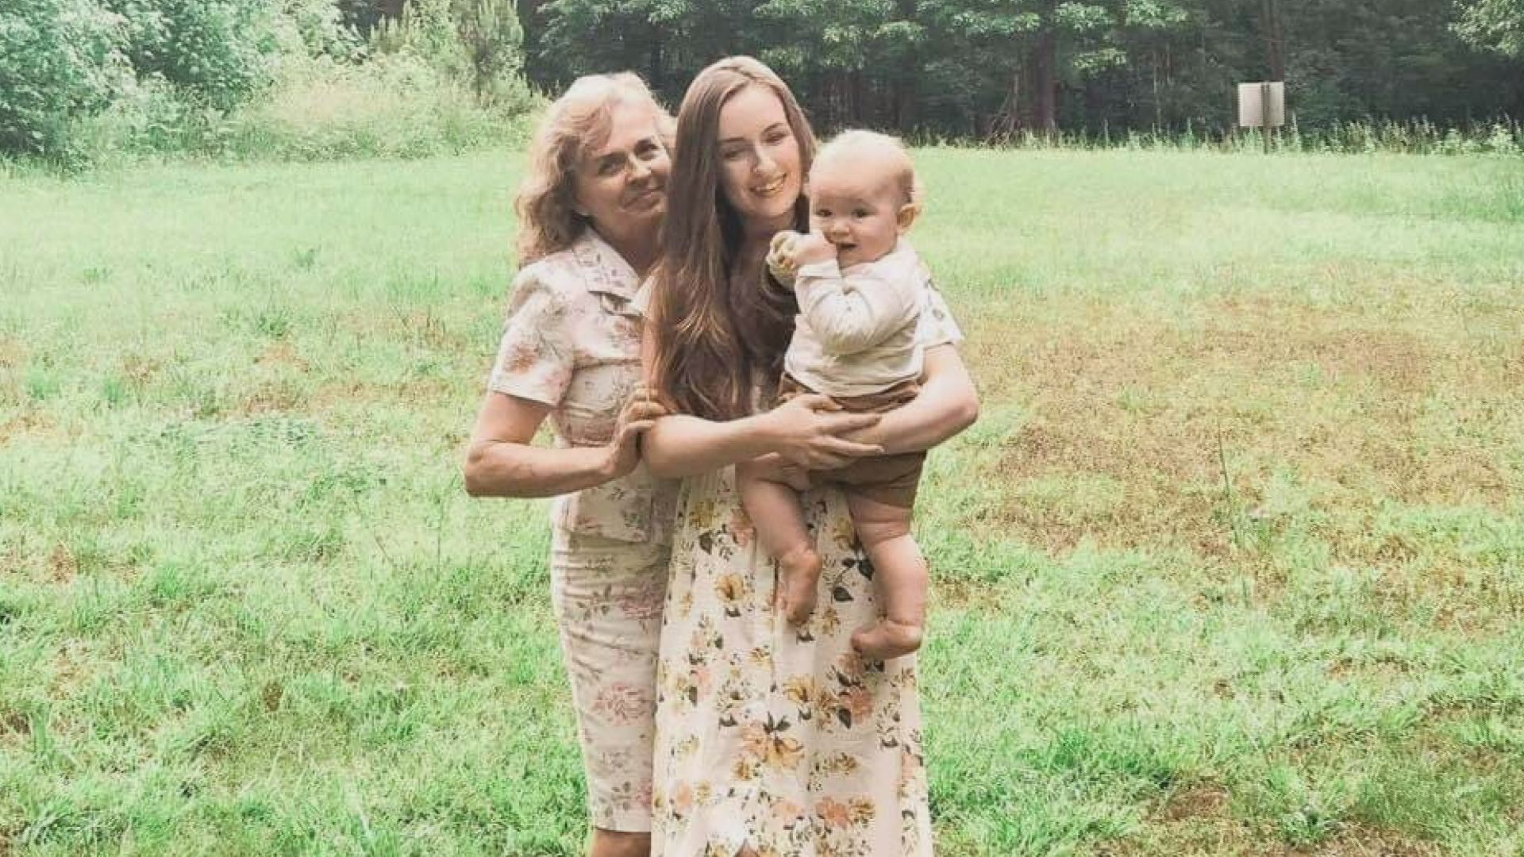
1. This is my mother, my cousin and my grandson.

Slide 5

2. My brother is a doctor.
He works in a hospital.

Slide 6
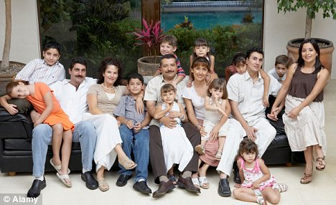
3. I have a big family.
We always share time together.

Slide 7
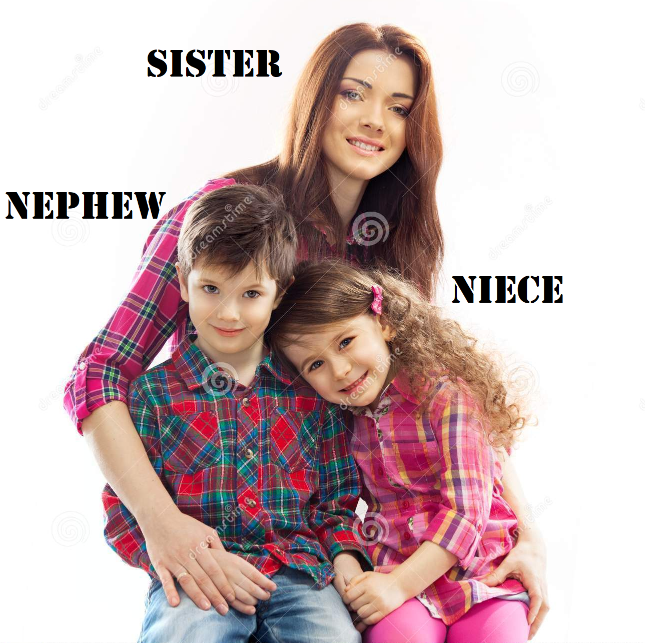
4. My sister has two children. They are my nephew and my niece.

Slide 8
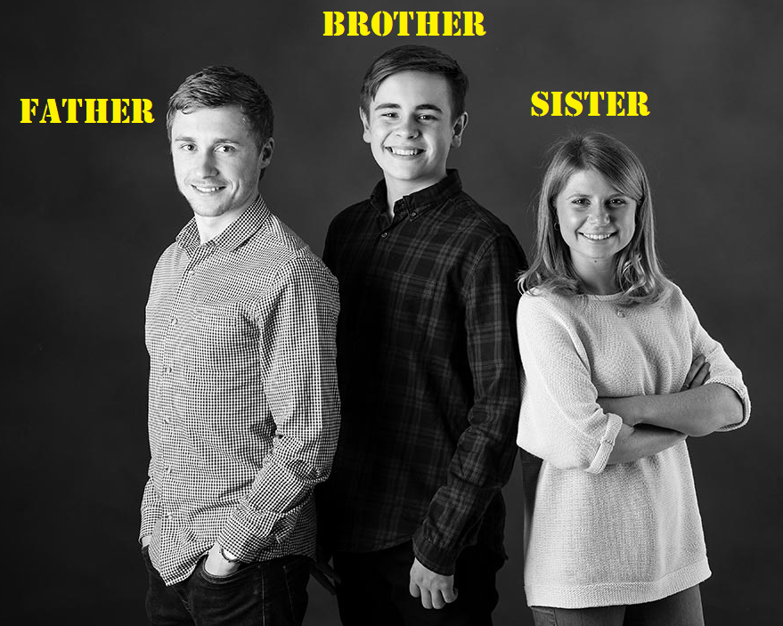
5. My father has two siblings. His brother is my uncle and his sister is my aunt.

Slide 9
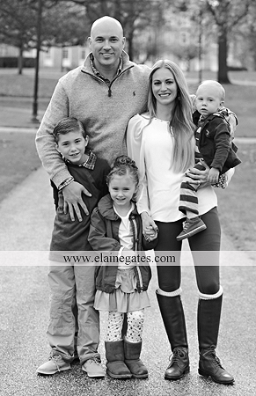
6. Michael is the husband and Lucy is the wife. They have one daughter and two sons.

Slide 10
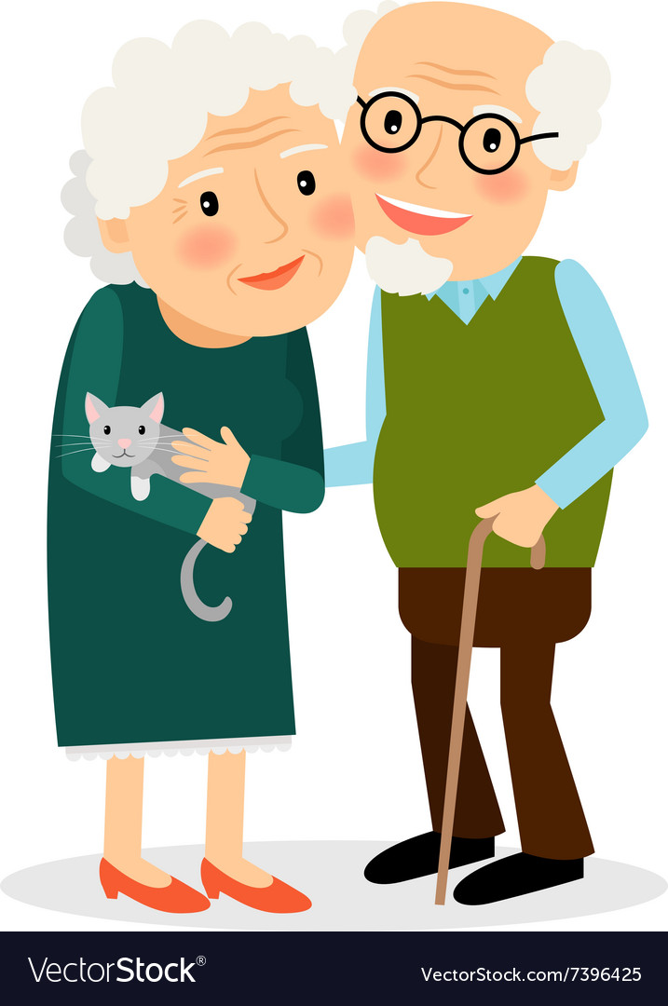
7. On Thanksgiving we are going to visit our grandmother and grandfather.

Slide 11
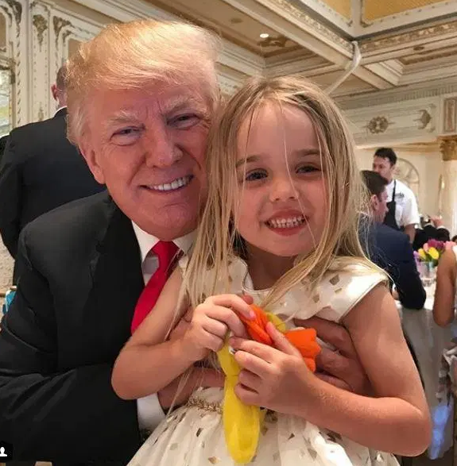
8. Our granddaughter’s birthday is next week

Slide 12
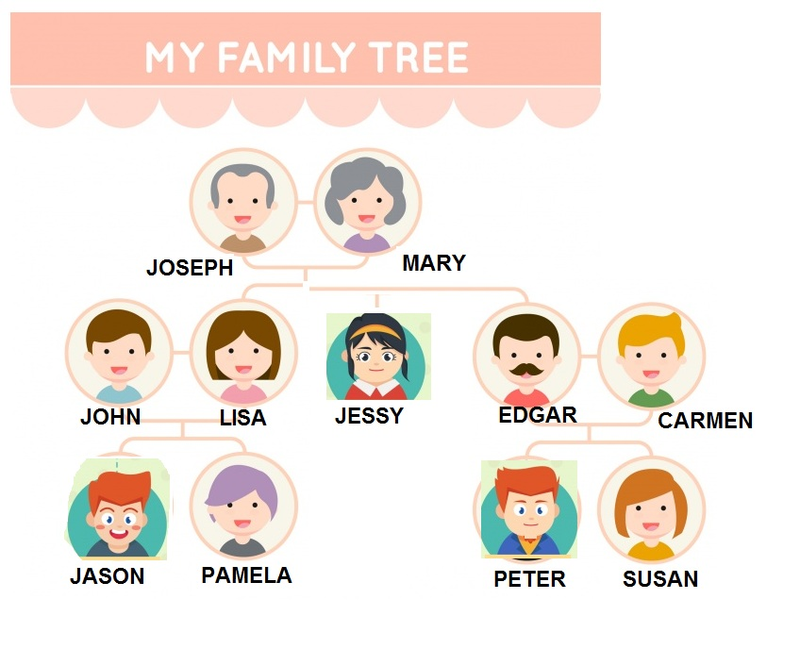
Exercises

Slide 13
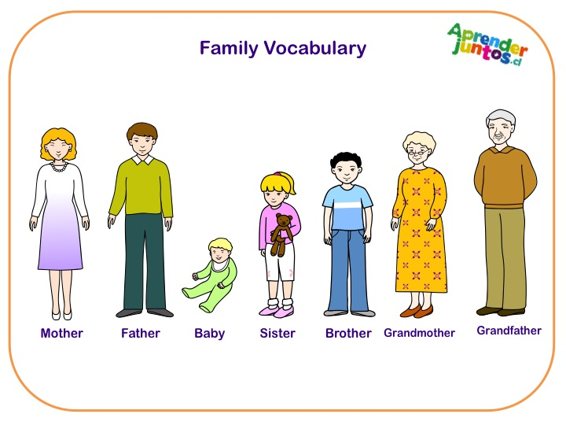
Complete the sentences
with the family members

Slide 14
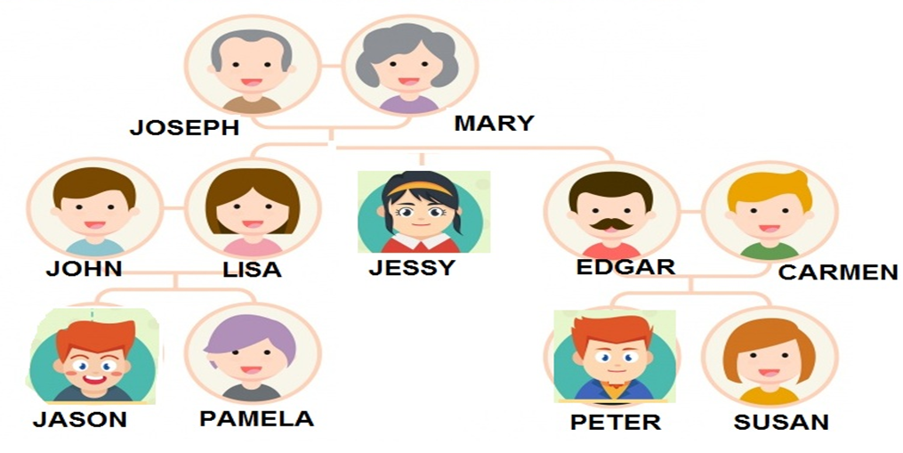
Hello my name is Lisa.
I’m married. My (brother – husband) is John.

Slide 15
2. Together we have 2 children. Jason is my (son – uncle)

Slide 16
Pamela is my beautiful
(daughter – mother)
She is very smart.

Slide 17
4. Jessy is my (niece - sister) She likes to listen to music.

Slide 18
5. Edgar is my (brother – uncle) His wife is Carmen.

Slide 19
6. Peter is Susan’s brother. Peter is my (husband - nephew)

Slide 20
7. Susan is Peter’s sister. Susan is my (wife - niece)

Slide 21
8. Joseph is my (father - uncle) and Mary is my (aunt - mother)

Slide 22


